Slide 1





Slide 2


NextFOOD Project - Objectives
The NEXTFOOD project drives the crucial transition to more sustainable and competitive agrifood and forestry systems development by designing and implementing education and training systems to prepare budding or already practising professionals with competencies to push the green shift in our rapidly changing society.
The NEXTFOOD project challenges the linear view of knowledge transfer as a top-down process from research to advice and practice, and support the transition to more learner-centric, participatory, action-based and action-oriented education and learning.
The objectives:
Create an inventory of the skills and competencies needed for a transition to more sustainable agriculture, forestry and associated bio-value chains (WP1)
Facilitate case studies to identify gaps and needs (WP2)
Test new relevant curricula and training methods (WP3)
Identify policy instruments that support the transition towards action-, and practice-oriented learning methods (WP4)
Peer-review tools for evaluating the quality of the practice-oriented research (WP5)
Create a platform for knowledge sharing (WP6)

Slide 3
WP4 - «Policy Assessment and Recommendation» Objectives
The activities under WP4 are aimed to identify policy instruments that support the transition towards action-, and practice-oriented learning methods.
The final aim will be to suggest new policy instruments on regional, national and EU-level that will improve the education and training systems for farmers, forest professionals, advisers and others, and that will support the sustainability challenges of the agrifood and forestry systems.

Slide 4
Task 4.1 «Policy assessment»
For this purpose, in the task 4.1 already completed, an online survey was launched at the end of June 2019 to gather information about the effectiveness of existing policies and their interaction as well as gaps.
The participants were 188 among stakeholders, farmers, teachers, researchers, experts, advisors, local and EU authorities and policymakers.
The survey addressed 4 policy fields of education and research:
Pre-university education (High school)
University education
Adult learning, vocational education and training
Training measures in agricultural, food and forestry sectors

Slide 5
Results of the survey
The results of the survey highligthed the following gaps in the current policy framework:
No or insufficient coordination among policy fields (EU, national and regional) and actors (university & industry).
Poor awareness on the existence of strategy documents that implement the agricultural education.
Insufficient amount of financial support especially for adult learning and vocational educations of young agrifood and forestry professionals.
Policies not much effective in providing innovative ways of learning (student-centred learning, interdisciplinarity, internationalization, mobility, networking).
Policies not much effective in promoting sustainability, entrepreneurship and innovation.
Policies not much effective in address completely the agricultural and forestry sector real needs.

Slide 6
Work to be done (Task 4.2):
“Identification of strategies for improvements”
The next step of the work is to Identify options and strategies for improving the actual educational policy framework. These suggestions will serve to propose new policy instruments, especially according to the recent Farm to Fork Strategy objectives.
This work is to be performed through a series of workshops performed in different countries and...
…you are invited to participate to one of this workshop.

Slide 7

Agricultural Knowledge and Innovation Systems (AKIS)
framework and concept
The term AKIS is used to describe the whole knowledge exchange system:
that is the ways people and organizations interact to promote mutual learning, to generate, share, and use agriculture-related knowledge and information.
Farmers, advisors, researchers, education and training providers, input suppliers, retailers, media services and ministries are all part of national or regional AKIS, since they all either need, produce or exchange knowledge and innovation for agriculture and interrelated fields.

Slide 8
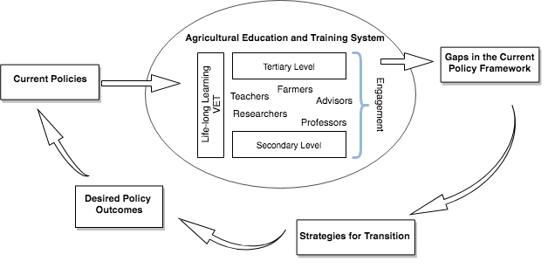
Agricultural Knowledge and Innovation Systems (AKIS) framework and concept
The figure summarize the AKIS framework in relation to the policy transition processes.

